Slide 1
Mutual Opportunities in Medical Services Iran & Sultanate of Oman 4th May 2019 فرصتهای همکاری مابین ایران و عمان در حوزه سلامت 14 اردیبهشت

Slide 2
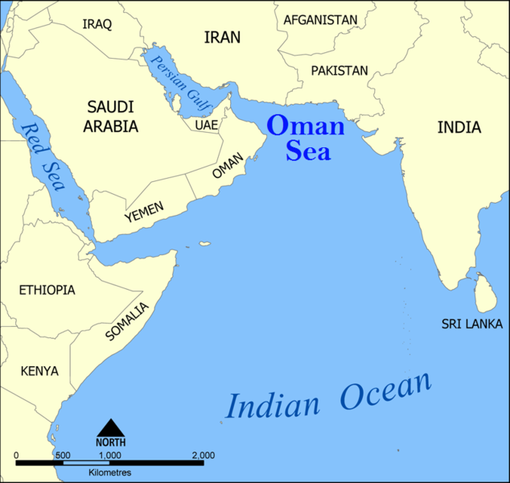
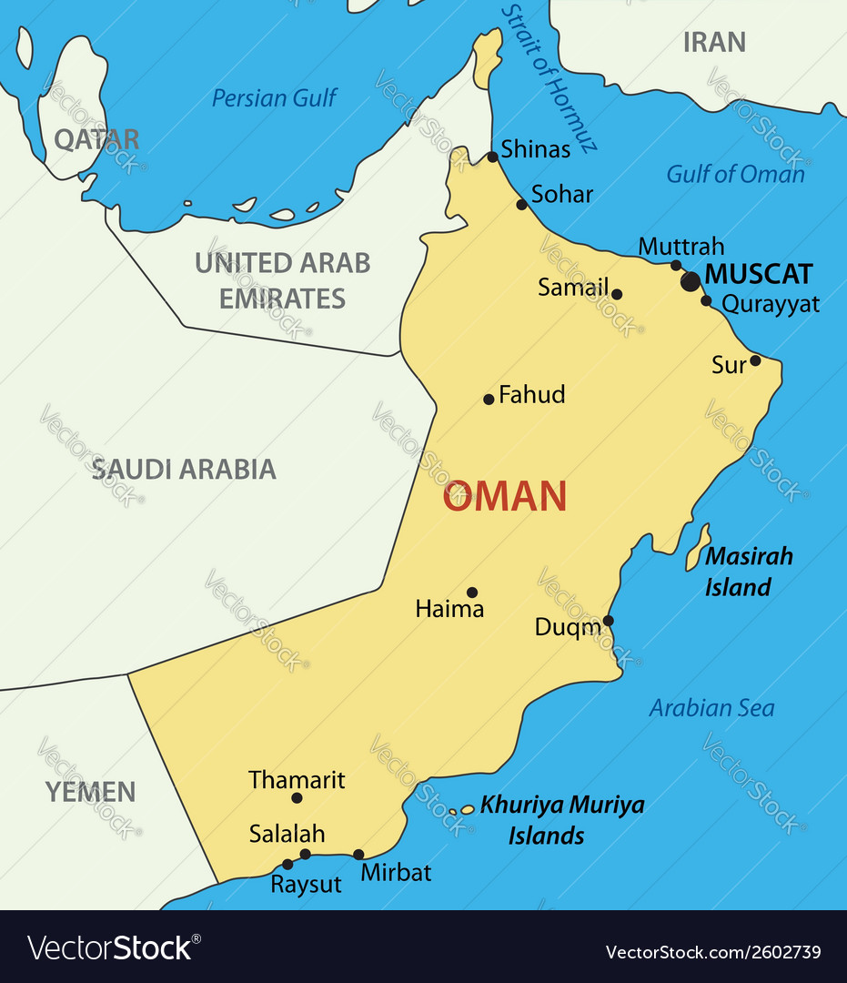
Sultanate of Oman

Slide 3
Sultanate of Oman Medical Services Market & Opportunities
2019 Outlook and Opportunities
ABBAS ZAIDI
May 4, 2019

Slide 4
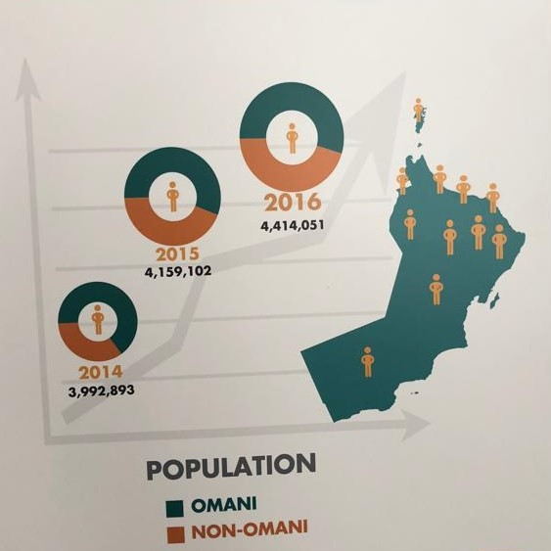
Sultanate of Oman
Population: On 29 April 2019
Omani 2,644,777 1,331,832 1,312,945
Ex-Pats 2,045,746 1,647,323 398,423
Total 4,690,523 2,979,155 1,711,368

Slide 5
Sultanate of Oman
Population: On 29 April 2019 Male Female
Omani 2,644,777 1,331,832 1,312,945
Ex-Pats 2,045,746 1,647,323 398,423
Total 4,690,523 2,979,155 1,711,368

Slide 6
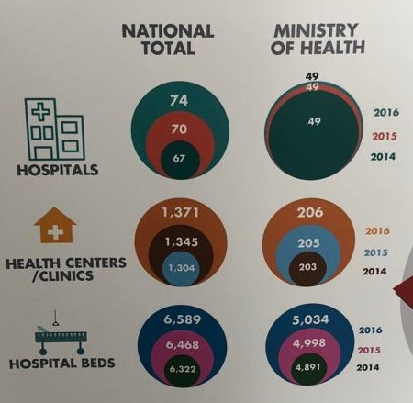
Medical Services Providers
Hospitals in Oman 76
Government Hospitals 49
Private Hospitals 27
Health Centers 1,484
Government 269
Private 1,215

Slide 7
Medical Services Providers
Hospitals Beds in Oman 6,696
(Government and Private)
Total Beds Per 10,000 14.7
Occupancy rate 61.8%
Averages days per stay 3.4

Slide 8
Medical Professionals
Doctors 9,132
Total Doctors Per 10,000 20
General Practitioners per 10,000 11.2
Specialists per 10,000 8.8
Nurses 19,938
Total Nurses Per 10,000 43.7

Slide 9
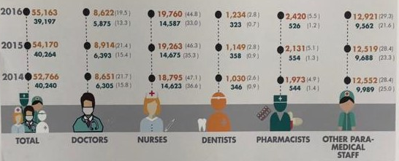
Medical Professionals
Doctors 9,132
Total Doctors Per 10,000 20
General Practitioners per 10,000 11.2
Specialists per 10,000 8.8
Nurses 19,938
Total Nurses Per 10,000 43.7

Slide 10
Medical Professionals
Dentists 1,350
Total Dentists Per 10,000 3
Pharmacists 2,445
Total Pharmacists per 10,000 5.4

Slide 11
Government Hospitals
General Hospitals
Free for All Omanis
Ex-pats have access through private insurance providers
Urban Centers – larger departments
Mix of nationalities in Professionals
Omanization
Special Service Hospitals
Free for Certain member Omanis and family
Urban Centers – larger departments
Mix of nationalities in Professionals
Omanization

Slide 12
Private Hospitals
Privately Operated Hospitals
Ownership: Omani 100%, Omani Sponsor, FTA based
Operated privately but regulated by MOH
Payments by Insurance or Cash equivalent
Ex-pats have access through private insurance providers
Other patients pay cash
Urban and populated locations
Community Orientated
Affiliations and group hospitals
Mix of nationalities in Professionals

Slide 13
Private Clinics
Privately Operated Clinics
Ownership: Omani 100%, Omani Sponsor, FTA based
Operated privately but regulated by MOH
Payments by Insurance or Cash equivalent
Urban, rural and populated locations
Affiliations and group clinics
Specialized, Poly and Split Services
Mix of nationalities in Professionals

Slide 14
Opportunities
Private Hospitals
Poly clinics
Specialized Clinics
Pharmaceutical
Medical Professionals
Medical Services – hard and soft
Medical devices, equipment and supplies
Manufacturing and production

Slide 15
Pharmaceutical and other Services
Pharmaceutical products – Finished, suppliments, herbal, traditional
Medical Equipment
Medical Supplies including disposables
Knowledge based medical services

Slide 16
Considerations
New Developments
Certification of all Medical professionals
Registration and licensing
Inspections and regulations
Operations and Administration
Financing and Banking
Payments and reimbursements
Taxes and Repatriation

Slide 17
How we can help you
Assisting you at any stage
Market Intelligence
Start – up support
Assist in Identifying key opportunities that match your objectives
Assist in creating a road map and business plan
Feasibility study including Commercial, Financial and Legal Advice
Assist in legal formalities with Ministry of Commerce and Industry
Assist in fulfilling Ministry of Health or other official requirements
Establishing of a legal entity

Slide 18
Thank you

Slide 19
Panel Discussion / Q&A

Slide 20
Mutual Opportunities in Medical Services Iran & Sultanate of Oman 4th May 2019 فرصتهای همکاری مابین ایران و عمان در حوزه سلامت 14 اردیبهشت

